Slide 1
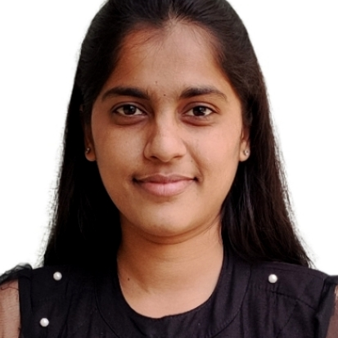

Apurva Sunilrao Gondkar
Analyst/Software Engineer
Bachelor of Civil Engineering : 2018-22
Skills
MUMBAI
C# | Basics, OOPS, Exception Handling ,Arrays ,Collection and Generics.
.NET Framework | ADO.NET, .NET 6 WEB API, Entity Framework , ASP .NET with MVC5.
Angular | Components, Models, Routing, Form and Validation
Database | SQL Server
Tools | GIT,SWAGGER, VISUAL STUDIO,VISUAL STUDIO CODE,SSMS.
UI Technology | HTML5 ,CSS & Angular
Add On Skills | Communication Skills, Peer Learning
apurva.gondkar@capgemini.com
+91 9373040330
A4
Full Stack Developer
Hands on experience on C#,ADO.NET,SQL Server ,ASP.NET MVC5 with WEBAPI
Knowledge on creating Single page web application using Angular.
Understanding of RDBMS concepts using SQL Server.
Practical understanding of C# and SQL concepts using Visual Studio and SQL Server
Hands on experience in developing web pages using HTML5,CSS,JavaScript
Having Knowledge on Git and GitHub.
Attended training on iTransform-Microsoft .Net
GitHub Link
Developed a WEB APPLICATION as part of case study using .NET WEBAPI , & ANGULAR.
DEGREED
Successfully completed the degreed training in Git,HTML,C#,.NET Core.
Woked on a Project as Case Study-
Developing a system for ROLL OFF
Tools Used: Platforms:
Visual Studio 2022 & VS code Google Cloud

